Slide 1
Methodologies
Explain how means of egress rules have been developed
Identify other methods of determining people movement
Explain the limitations of existing methodologies

Slide 2
Historic Fire
Daegu Subway

Slide 3
Origins of Egress Requirements
Stair width
First building code (1905): 20 in
NFPA committee (1913): 44 in, handrails protrude 3.5 in
Based on people standing in stair (28 per floor)
22 in per person on every other tread (from soldiers standing in line)
“Sufficient” to prevent three people from forming arch and blocking traffic
Why stairs are based on single floor at a time

Slide 4
Flow Method
Based on number of people per minute per exit lane
Level 60 persons/min
Stairs 45 persons/min
Stairs later found to be closer to 27 persons/min
Still used in NFPA 130
Time based
4 min for platform
6 min to point of safety
Level
2.08 persons/in-min
124 ft/min
Stairs
1.41 persons/in-min
48 ft/min (vertical)

Slide 5
Level of Service
Concept from transportation
Pathfinder allows you to view
Ability of people to freely choose their own speed
A: Free to choose own speed and pass
B: Free to choose own speed and pass, minor conflicts
C: Speed and passing restricted, major conflicts
D: Cannot pass
E: Intermittent stoppages
F: Movement to shuffle, not suited for design

Slide 6
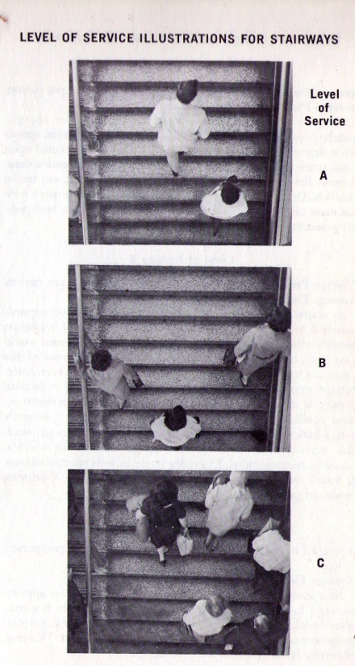
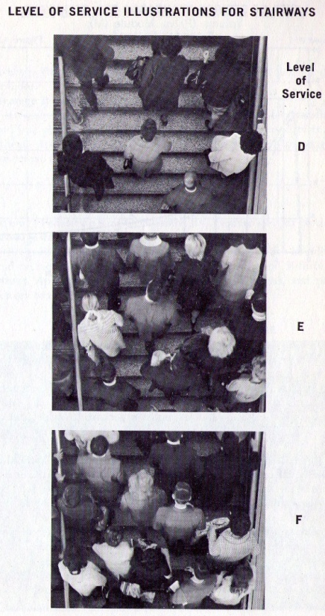
Level of Service

Slide 7
Behavior

Slide 8
Behavior

Slide 9
Behavior
Stairs
Preference

